Slide 1
Quantitative Composition of Compounds
Chapter 7

Slide 2
Avogadro’s Number
How do we count atoms?
Dozens? Reams?

Slide 3
1.0079 amu = 1 atom hydrogen
40.078 amu = 1 atom calcium
55.847 amu = 1 atom iron
1.0079 g H = ???? Hydrogen atoms
40.078 g Ca = ??? Calcium atoms
55.847 g Fe = ??? Iron atoms

Slide 4
Mole
The number of particles in the atomic mass in grams of an element (molecular mass for a compound)
6.022 x 10²³ particles

Slide 5
An orange truck contains 5 dozen oranges, how many oranges are in the truck?
A sand truck contains 5 moles of sand, how grains of sand are in the truck?
An orange truck contains 5.62 x 10⁷ oranges. How many moles of oranges are in the truck?
A bug truck contains 5 moles of spiders. How many moles of spider legs are in the truck?

Slide 6
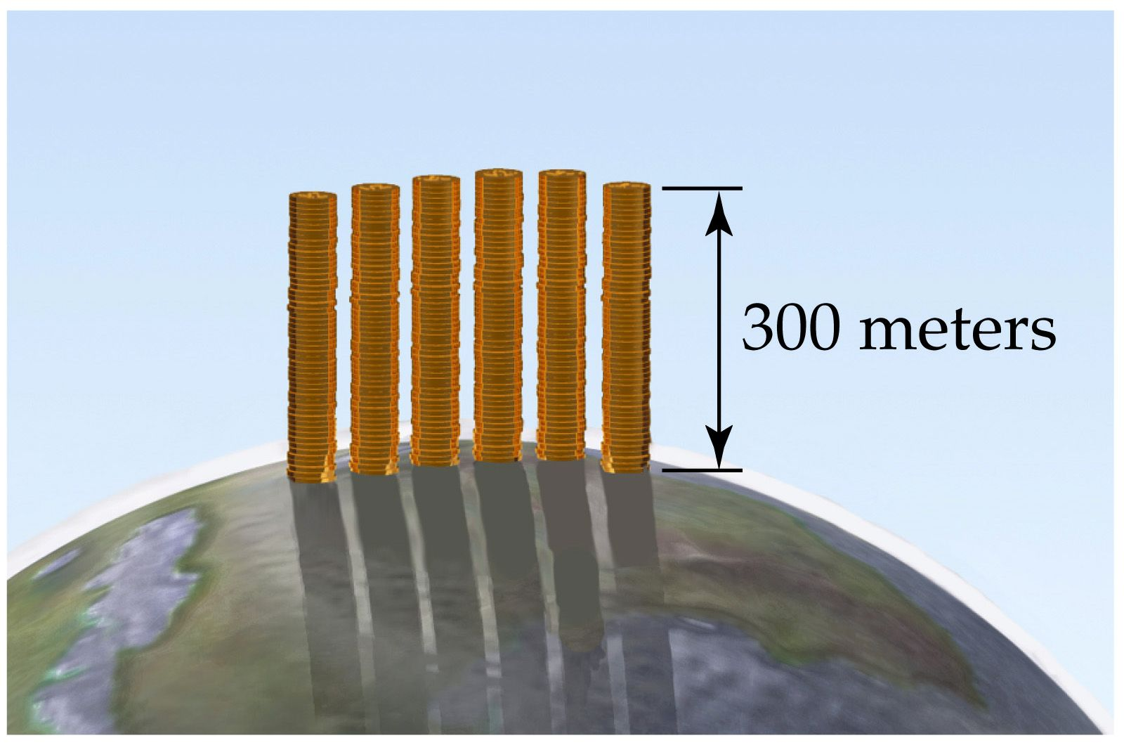

Slide 7
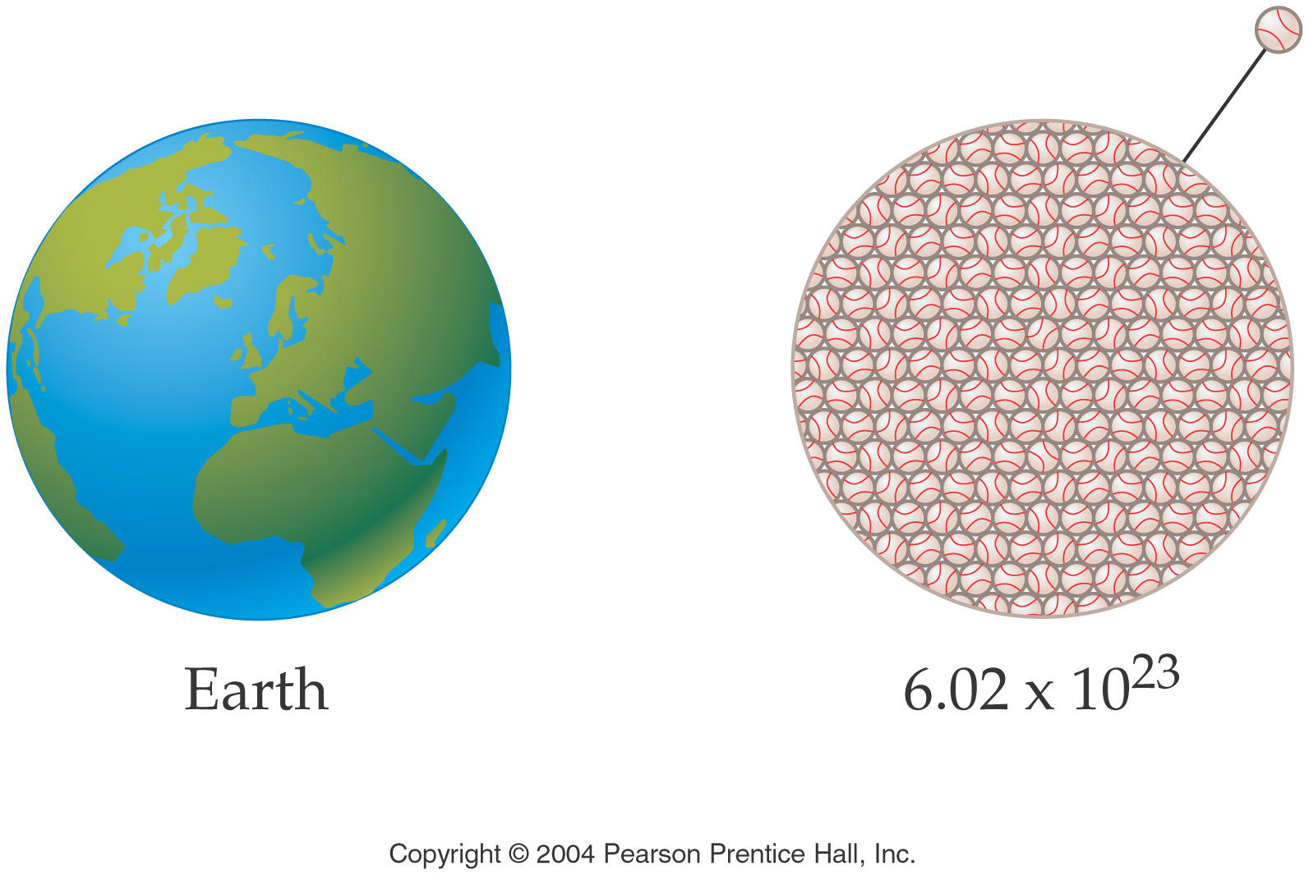

Slide 8
How many atoms of platinum are in 4.21 mol of platinum?
How many molecules of methane (CH₄) are in 0.286 mol of methane?
How many formula units of potassium bromide are in 0.50 mol of potassium bromide?

Slide 9
Molecule - The simplest representative particle in a compound composed of nonmetals
Formula unit - The simplest representative particle in a compound composed of ions.

Slide 10
Helium (He) is a valuable gas used in industry, low temperature research, deep sea diving, and balloons. How many moles of He are in 6.46 g of He?
Zinc (Zn) is a silvery metal that is used to form brass (with copper) and to plate iron to prevent corrosion. How many grams of Zn are there in 0.356 mol of Zn?
Silver (Ag) is a precious metal used mainly in jewelry. What is the mass of one silver atom?

Slide 11
Atomic mass – mass of an element
Molar mass – mass of a compound
= Σ atomic masses of constituent elements
(Also known as molecular mass, formula mass, molecular weight, formula weight, etc.)

Slide 12
Calculating molecular (formula) masses
KCl
39.09 + 35.45 = 74.54 amu
C₂H₆
2(12.01) + 6(1.008) = 30.08 amu
Ca₃(PO₄)₂
3(40.08) + 2(30.97) + 8(16.00) = 310.18 amu

Slide 13
Calculate the number of moles of carbon in 3.54 moles of methane.
Calculate the number of moles of hydrogen in 3.54 moles of methane.
Calculate the number of moles of methane gas(CH₄) in 3.29 grams of methane.
Calculate the number of grams of methane in 2.54 mole of methane.

Slide 14
How many atoms of oxygen are in 12 formula units of Ca₃(PO₄)₂?
How many formula units of calcium phosphate contain 27 atoms of Ca?
How many phosphorous atoms will be in a sample of calcium phosphate containing 33 atoms of Ca?

Slide 15
Lead(II)chromate, PbCrO₄, is a yellow pigment used in paint known as chrome yellow.
If you precipitate 45.6g of lead(II)chromate, how many moles do you precipitate?
How many formula units of lead(II)chromate precipitate?
How many moles of lead are there in the sample?
How many atoms of lead are there in the sample?
How many moles of oxygen atoms are there in the sample?
How many atoms of oxygen are there in the sample?

Slide 16
Nitric acid, HNO₃, is a colorless, corrosive liquid used in the manufacture of nitrogen fertilizers and explosives. How many atoms of O are in a 28.5 g sample of nitric acid?
Hydrogen cyanide (HCN) is a volatile, colorless liquid with the odor of certain fruit pits (peach and cherry). The compound is highly toxic. What is the mass of 3.14 x 10¹⁹ molecules of HCN?

Slide 17
For glucose (C₆H₁₂O₆) calculate
Molecular mass
Number of molecules in 8.35 mol glucose.
Number of atoms oxygen in 9.43 mol glucose.
Number of molecules in 29.4 g glucose.
Number of atoms of carbon in 29.4 g glucose.
Moles of carbon in a glucose sample containing 4.22 mol hydrogen.
Mass of hydrogen in 3.59 x 10²⁵ molecules glucose.

Slide 18
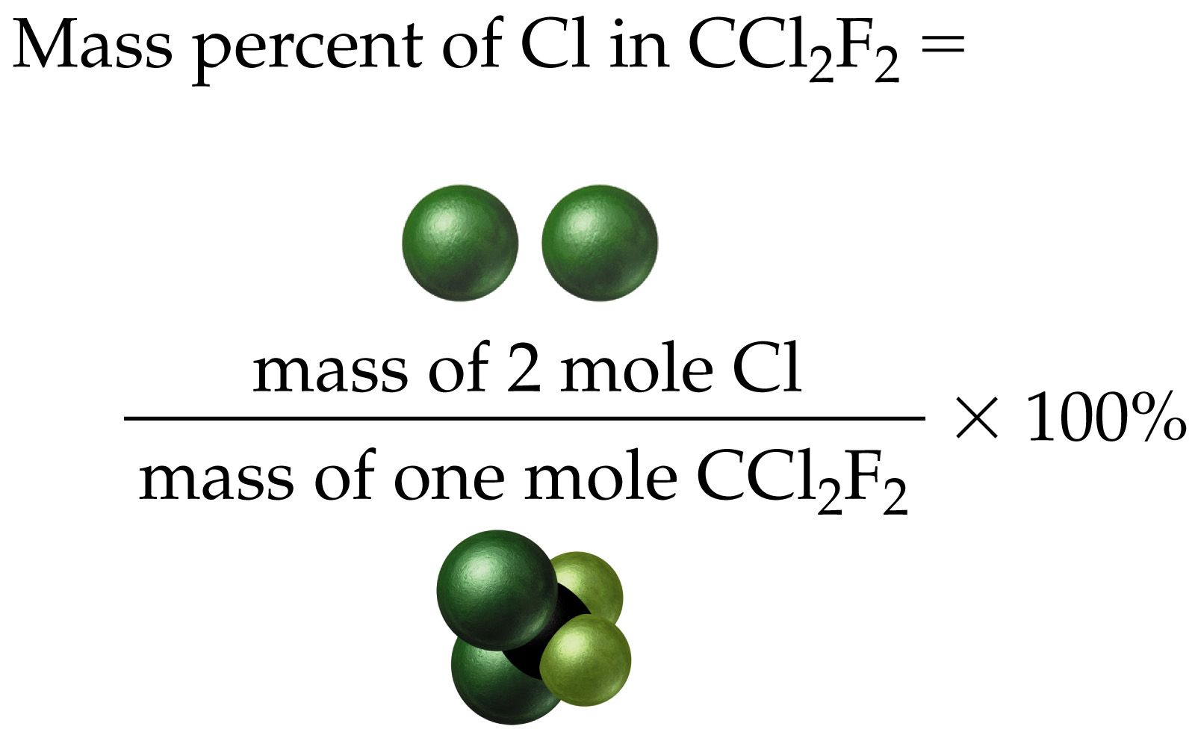

Slide 19
Sodium nitrite (NaNO₂) is a food preservative that is added to ham, hot dogs, and bologna. In recent years its use has come under attack because it has been shown to lead to cancer in certain animals. Calculate the percent composition by mass of Na, N and O in NaNO₂.

Slide 20
Calculate the percent composition of stearic acid, C₁₈H₃₆O₂, a principle component of saturated fat.

Slide 21
Empirical Formula
The formula for a compound that is determined experimentally.
A formula that represents the lowest integral ration of atoms of the elements in a compound.
The simplest formula for a compound.

Slide 22
compound | molecular formula | empirical formula
hydrazine | N₂H₄ | NH₂
peroxide | H₂O₂ | HO
water | H₂O | H₂O
glucose | C₆H₁₂O₆ | CH₂O

Slide 23
The major air pollutant in coal burning countries is a colorless, pungent gaseous compound containing only sulfur and oxygen. Chemical analysis of a 1.078 g sample of this gas showed that it contained 0.540 g of S and 0.538 g of O. What is the empirical formula of this compound?

Slide 24
Empirical Formula from % Composition
Polystyrene, a well-known plastic, is composed of 92.26% carbon and 7.74% hydrogen.
How many grams of each element are in 100 grams of polystyrene?
How many moles of each element are in 100 g of polystyrene?
What is is the mole ratio in integers?
What is the empirical formula?

Slide 25
What is the empirical formula? Ascorbic acid (vitamin C) cures scurvy and may help prevent the common cold. It is composed of 40.92% C, 4.58% H, and 54.50% O. Determine the empirical formula of vitamin C.

Slide 26
TNT, trinitrotoluene, is composed of 37.01% carbon, 2.22% hydrogen, 18.50% nitrogen, and 42.26% oxygen. Determine its empirical formula.

Slide 27
Converting Empirical Formulas to Molecular Formulas
Determine the molar mass of empirical formula
Determine ratio of molar mass compound to molar mass empirical formula.
(MM actual/MM empirical formula)
Determine number of units of empirical formula in overall compound.

Slide 28
Converting Empirical Formulas to Molecular Formulas
The empirical formula of acetic acid (the important ingredient of vinegar) is CH₂O. What is the molecular formula of the compound, given that its Molar mass is around 60 g/mol?

Slide 29
A compound containing only sulfur and nitrogen is 69.6% S by mass; the molar mass is 184 g/mol. What are the empirical and molecular formulas of the compound?

Slide 30
Fluorocarbonyl hypofluorite was recently isolated, and analysis showed it to be 14.6% C, 39.0% O, and 46.3% F. If the molar mass of the compound is 82 g/mol determine the empirical and the molecular formula for the compound.

Slide 31
Additional mole practice
What is the mass of 3.554 x 10²⁵ atoms of selenium? (4660. g Se)
How many atoms are in 2.500 g of platinum? (7.717 x 10²¹ atom Pt)
What is the mass of one atom of lead(Pb)? (3.44 x 10⁻²² g Pb)

Slide 32
Additional mole practice
Calculate the number of moles in 200 mg of a (1 carat) diamond (C). (0.0167 mol C)
How many moles of formaldehyde (CH₂O MM=30.03) are present in 65.0 g of formaldehyde? (2.16 mol CH₂O)
What is the mass of 1 atom of gold?
(3.27 x 10⁻²² g Au)

Slide 33
Methane (CH₄) is the principle component of natural gas. How many moles of CH₄ have a mass of 6.07 g? (0.378 mol CH₄)
Boron(B) is a rare nonmetallic element. It is almost as hard as diamond, which is the hardest substance known. How many atoms are in 0.500g of B? (2.79 x 1022 atom B)
Hydrogen peroxide, H₂O₂, is a colorless liquid. A concentrated solution of it is used as a source as oxygen for rocket propellant fuels. What is the mass of 0.909 mol of H₂O₂? (29.9 g H₂O₂)

Slide 34
Additional mole practice
The artificial sweetener Nutrasweet is the compound aspartame, with the molecular formula C₁₄H₁₈N₂O₅. What is the molecular mass of aspartame? (294.30 amu)
What is the mass of 0.362 mol of aspartame? (107 g)
How many molecules of aspartame are there in 2.55 grams of aspartame? (5.22 x 10²¹ molecules)
How many atoms of oxygen are there in 2.55 grams of aspartame? (2.61 x 10²² atom O)

Slide 35
Male silkworm moths are attracted to an organic sex attractant with a molecular mass of 238. If 4.10 x 10⁻⁶ g of this attractant is released into a room, how many molecules of attractant are in the room? (1.04 x 10¹⁶ molecules)
How many atoms of carbon are present in 1.00 g of CH₄O? (1.88 x 10²² atoms C)

Slide 36
How many moles of water contain 5.23 x 10²⁴ molecules of water? (8.68 mol water)
Aluminum (Al) is the third most abundant element in the earth’s crust. It is used in transmission lines, aircraft, and beverage cans. What is the mass in grams of 1.000 x 10¹² (one trillion) Al atoms? (4.48 x 10⁻¹¹ g Al)
How many moles of nitrogen are in a sample of oxalamide (C₂H₄N₂O₂) that contains 6.4 moles of hydrogen? (3.2 mol N₂)

Slide 37
Adipic acid is used in the manufacture of nylon. The composition of the acid is 49.3% C, 6.9% H, and 43.8% O (by mass), and the molecular weight is 146 amu. What is the molecular formula?
Empirical formula (C₃H₅O₂)
Molecular formula (C₆H₁₀O₄)

Slide 38
What is the empirical formula for ibuprofen, a headache remedy? Ibuprofen contains 75.69% C, 15.51% O and 8.80% H.
(C₁₃H₁₈O₂)

Slide 39
Phenol, commonly known as carbolic acid, was used by Joseph Lister as an antiseptic for surgery in 1865. Its principal use today is in the manufacture of phenolic resins and plastics. Combustion of 5.23 g of phenol yields 14.7 g CO₂ and 3.01 g H₂O. Phenol contains only C, H, and O. What is the empirical formula of phenol?
(76.5% C, 6.44% H, 17.1% O, C₆H₆O)

